Slide 1
IT253 OPERATING SYSTEMS
DR. JANANI T
ASSISTANT PROFESSOR
DEPT OF IT, NITK

Slide 2
About the course
Course Code : IT253
L T P: 3 0 2
Contact hours: 3 per week – Lecture & 2 per week – Lab
Pre-requisites: Basic C programming, Basic shell programming, Computer Organization
Rubrics: Theory: (75%)
20% Mid-sem Theory Exam – As per the academic calendar [Feb-18 – Feb-24]
40% End Sem Theory Exam -As per the Academic calendar [April-23 – May-03]
15% Quiz/Assignment/Test
Quiz I: Feb-12 (Tentative)
Test: March 26 (Tentative)
Quiz II: April 15 (Tentative)
Lab: (25%)
15% Regular lab
Mini project (10%) Mid-sem: March-11 to March 13(Tentative)
End Sem: April 14 & April 15 (Tentative)

Slide 3
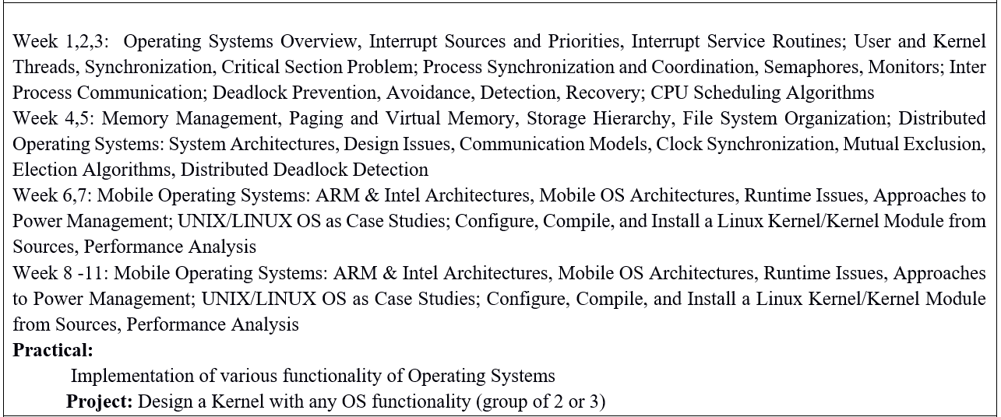

Slide 4
Text Books and/or Reference Books:
1. Andrew S. Tannenbaum and Herbert Bos, Modern Operating Systems, 4th Edition, Pearson, 2015
2. Abraham Silberschatz et al., Operating System Concepts, 9th Ed., John Wiley, 2012.
3. Harvey M. Deitel et al., Operating System, 3rd Edition, Pearson, 2007.
4. William Stallings, Operating Systems: Internals and Design Principles. 9th Ed., Pearson, 2017.
5. M. J. Bach. Design of the Unix Operating System, 1st Edition, Pearson, 2015.
6. Jonathan Corbet et al., Linux Device Drivers, 4th Edition, O'Reilly, 2013.

